Slide 1
Ethan Wells
Goals for the week
  Prepare the LISA dataset (US traffic signs) for training.
  Test the trained German-sign (GTSRB) model.
Progress for the week
  Neither machine-learning goal was started — getting the CM5 ready for hardware testing took priority so the team has a working board to bench-test sensors on.
  Assembled the CM5 on the Compute Module 5 IO Board with the ZDE heatsink/PWM fan, CR2032 RTC cell, and 27 W USB-C power supply.
  Flashed Raspberry Pi OS Lite (64-bit) to the 128 GB KIOXIA NVMe SSD and booted the CM5 from M.2.
  Brought up headless SSH over the USB Wi-Fi dongle (the CM5 has no onboard wireless).
  SSH over Wi-Fi was painfully slow; traced it to the dongle’s stock driver and replaced it with a working RTL8188EUS build.
  Purchased the remaining compute parts: NVMe SSD, USB NVMe enclosure, heatsink + PWM fan, 27 W power supply, CR2032 battery, and TP-Link Wi-Fi dongle.
Goals for next week
  Prepare the LISA dataset (US traffic signs) for training.
  Test the trained German-sign (GTSRB) model.
Hours spent on progress
  7 hours.

Slide 2
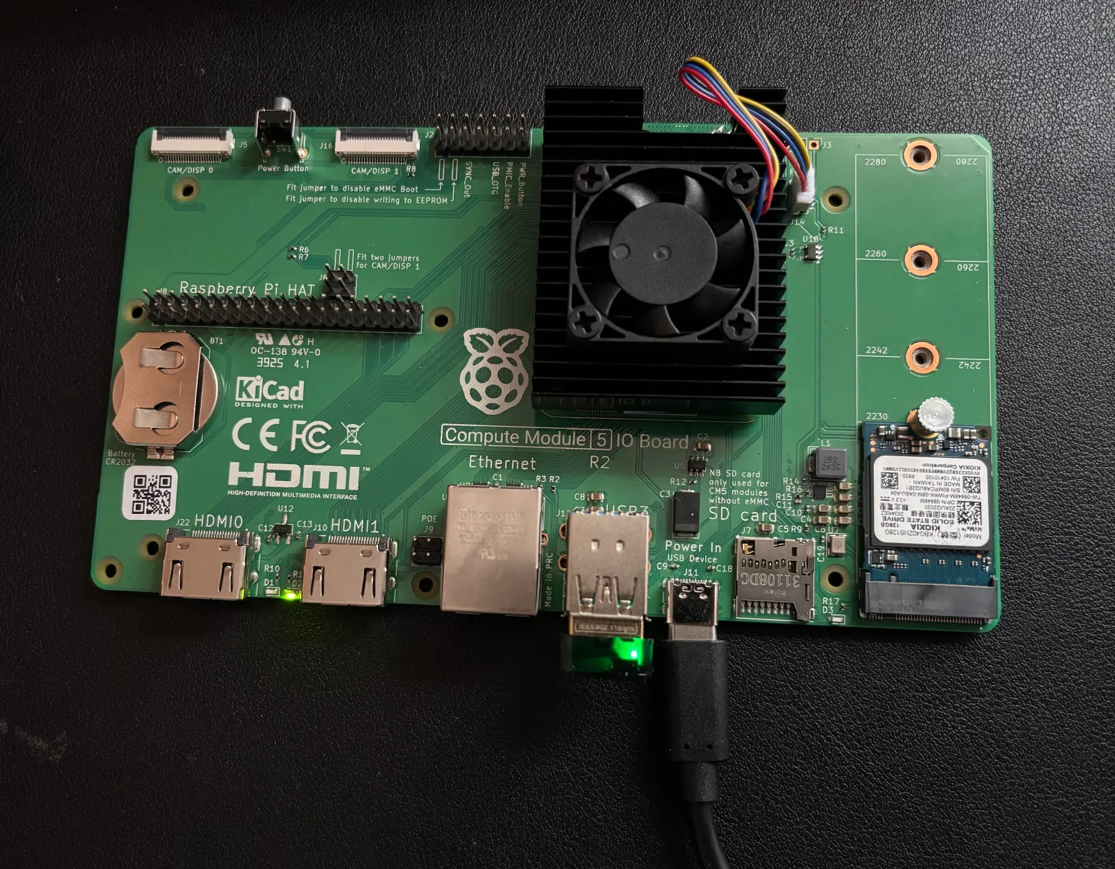
CM5 Bring-Up
• CM5 seated on the Compute Module 5 IO Board
• Heatsink + PWM fan, CR2032 RTC cell, 128 GB NVMe SSD in the M.2 slot
• Powered by the 27 W USB-C supply; boots Raspberry Pi OS Lite (64-bit) from NVMe
• Accessed headless over SSH through the USB Wi-Fi dongle

